Slide 1
Linked Open Data and Knowledge Graph
Final Project Presentation
OpenAlex
Seite 1

Slide 2
Agenda
Introduction of OpenAlex (Scope, Why did we choose it, and what it does)
Entities and Relationships covered
Methods and Material used (Data Extraction -> API)
Data Preprocessing
Neo4j + Cypher queries
Knowledge Graphs
Visualization with Gephi
Demo
References

Slide 3
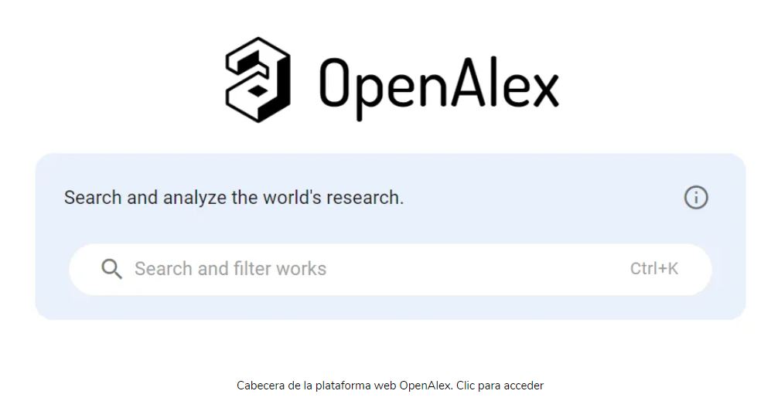
OpenAlex
A large-scale, open-source platform of scholarly works, authors, institutions, concepts etc
Designed to replace Microsoft Academic Graph (MAG) after it was discontinued
https://www.lluiscodina.com/openalex-scopus/

Slide 4
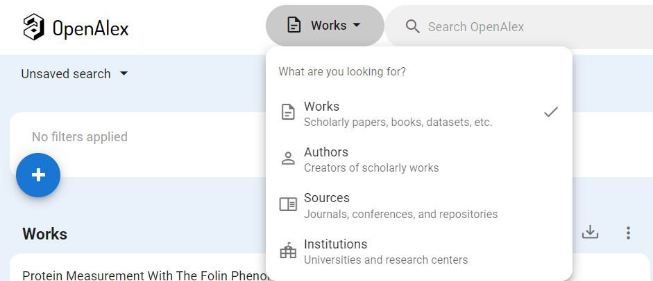
OpenAlex Scope
Millions of Works (papers, proceedings etc.)
Works, Authors, Institutions, Venues (journals/conferences), Concepts (subjects/topics)

Slide 5
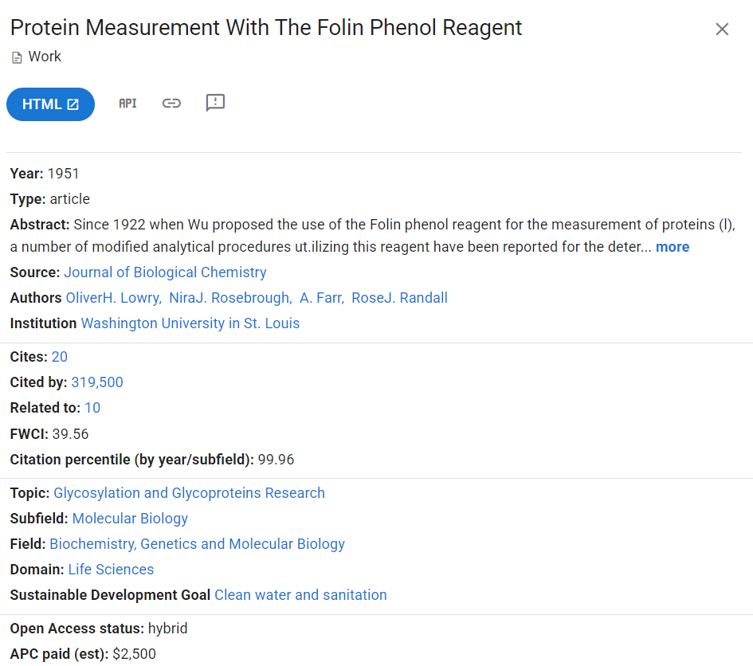
Why did we choose OpenAlex?
Rich Metadata: Includes metadata for authors, works, venues, institutions, and research topics
Ideal for Knowledge Graphs: Structured data that naturally maps to nodes and edges
API Access: Offers a robust API for easy data retrieval and integration into research projects.
Open Licensing: Operates under an open license, ensuring unrestricted access and use.
Use Cases: Ideal for bibliometric analysis, research trend exploration, and knowledge graph building.

Slide 6
What does OpenAlex do?
The ancient Library of Alexandria aimed to create a universal collection of scholarship, indexed using the first library catalog, the Pinakes. They're working towards the same goal, but making it completely open.
Their data is free and reusable, available via bulk download or API,
their code is fully open-source;
they're governed by a sustainable and transparent nonprofit.
OpenAlex believes the global research system is one of humankind's most beautiful creations. They aim to make that whole beautiful creation available to everyone, everywhere.

Slide 7
Data Extraction possibilities – Breakdown Summary
Features | API Access | Dataset Snapshots
Data Freshness | Real-Time updates | Static at export
Data Volume | Paginated, limited | Full database
Latency | Higher for large pulls | Local, faster access
Technical Skill | Moderate | Advanced
Scalability | Limited by rate limits | Supports big data
Storage Needs | Minimal | High

Slide 8
Entities and Relationships covered
Work – AUTHORED_BY → Author
Author – AFFILIATED_WITH → Institutions
Work – PUBLISHED_IN → Year
Work – HAS_Topic → Topics
Work – BELONGS_TO → Domain
Work – CITES → Work
Yet to be covered..!

Slide 9
Why these Relationships?
Captures the most critical scholarly links (authorship, institutional affiliation, venue, topical concepts, citations).
Provides a solid core for building a Scholarly Knowledge Graph.
Additional possible extensions:
Cited_by relationships (larger scale, more API calls) - problem emerged here
Concept-to-Concept hierarchies (e.g., broader/narrower concepts)
Author-to-Institution direct links

Slide 10
Methods and Material used
Approach used:
Python scripts in Google Colab.
Accessed circa 5,000 Works (25 pages × 200 items/page) using the OpenAlex API.
Implemented a small delay (time.sleep) to avoid rate-limit issues.

Slide 11
Methods and Material
Core Python Libraries:
requests: for API calls
pandas: for data manipulation (DataFrames, CSV export)

Slide 12
Methods and Material
Data Modeling:
Stored each record as (subject, relationship, object)
Used unique OpenAlex IDs for Works (e.g., Wxxxx), Authors (Axxxx) etc.

Slide 13
Methods and Material
Knowledge Graph Construction:
Built a large list of (subject, relationship, object) triples
Exported to CSV for further analysis in Neo4j and graph visualization (Gephi)

Slide 14
Data Preprocessing – Cleaning and Preparing Relationships
Duplicates Removal: Ensured no repeated triples;
Null Checks: Filtered out any rows missing subject/relationship/object;
Simple Schema: Kept relationships minimal and consistent (e.g., “CITES,” “AUTHORED_BY,” etc.);

Slide 15
Data Preprocessing
Transforming for Gephi:
Created two main files: nodes.csv (all unique IDs + types) and edges.csv (source, target, relationship)
This structure is Gephi-friendly for network visualization

Slide 16
Data Preprocessing
Potential Extensions:
Additional columns for weighting edges (e.g., citation frequency);
Enhanced node metadata (e.g., year published, author name);

Slide 17

Introduction to Neo4j
Neo4j is a graph database platform designed to store, query, and analyze data as a network of nodes and relationships, reflecting real-world connections. Unlike traditional relational databases, Neo4j uses a graph-native architecture, making it highly efficient for handling connected data. With its intuitive Cypher query language, it enables users to explore complex relationships and gain insights quickly, making it ideal for applications like fraud detection, recommendation systems, and social network analysis.

Slide 18
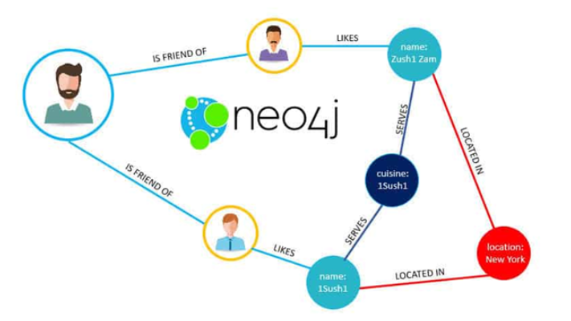
Why did we choose Neo4j?
Graph-native database that mirrors real-world connections.
User-friendly Cypher query language for complex analysis.
Delivers real-time insights for highly connected data.
Scalable and efficient for large datasets.
Flexible and adapts to evolving data models.
Supported by a strong community and learning resources.

Slide 19
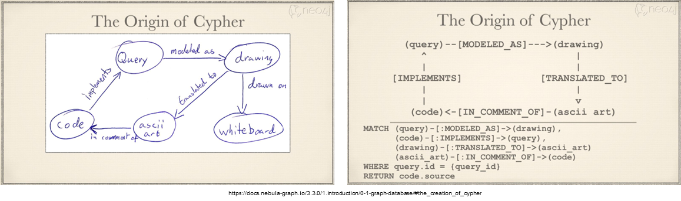
Introduction to Cypher Queries
Designed for querying graph data with a simple, declarative syntax.
Supports pattern matching to explore nodes and relationships.
Enables efficient path traversal and complex data queries.
Includes built-in functions for filtering, aggregation, and analysis.
Easily integrates with Neo4j and popular programming languages.
Notes:
Ease of Querying with Cypher: The Cypher query language is like writing a conversation. For instance, if I want to find "friends of friends" or "popular restaurants liked by friends in New York," I can write simple, human-readable queries instead of complex SQL joins.

Slide 20
Steps to create knowledge graph in Neo4j.
Step 1: Creating Database in Neo4j
Step 2: Preparing data for import
Step 3: Upload csv files to Neo4j
Let's take an example of creating a knowledge graph of Work Published_In Year relationship.

Slide 21
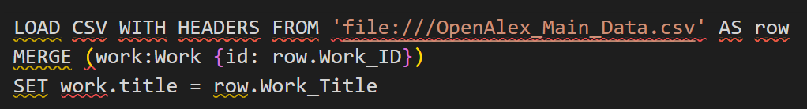
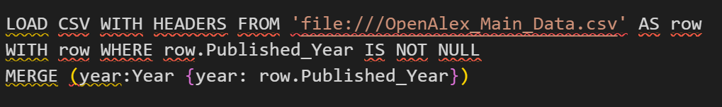
Steps to create knowledge graph in Neo4j.
Step 4: Creating Work nodes
Step 5: Creating Year nodes

Slide 22
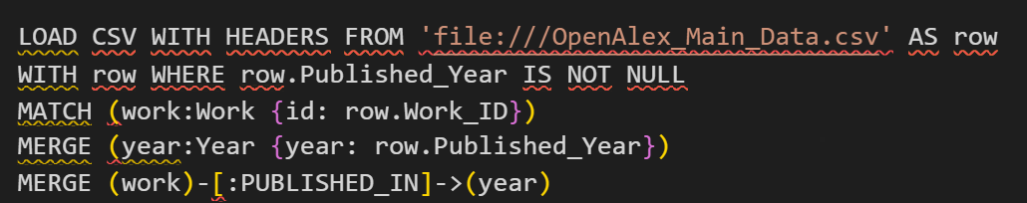
Steps to create knowledge graph in Neo4j.
Step 6: Creating Relationship of PUBLISHED_IN between Work and Year

Slide 23
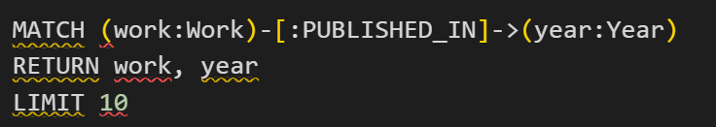
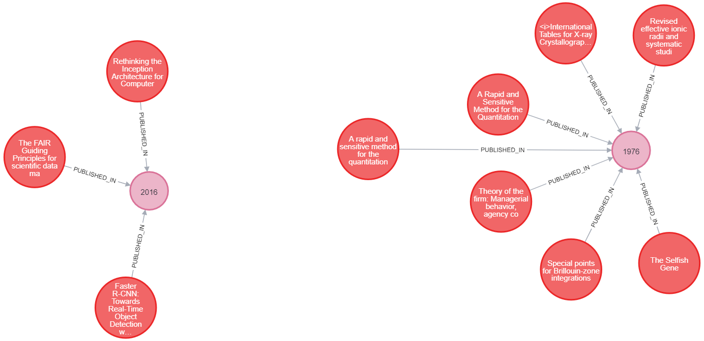
Steps to create knowledge graph in Neo4j.
Step 7: Visualizing Relationship of PUBLISHED_IN between Work and Year

Slide 24
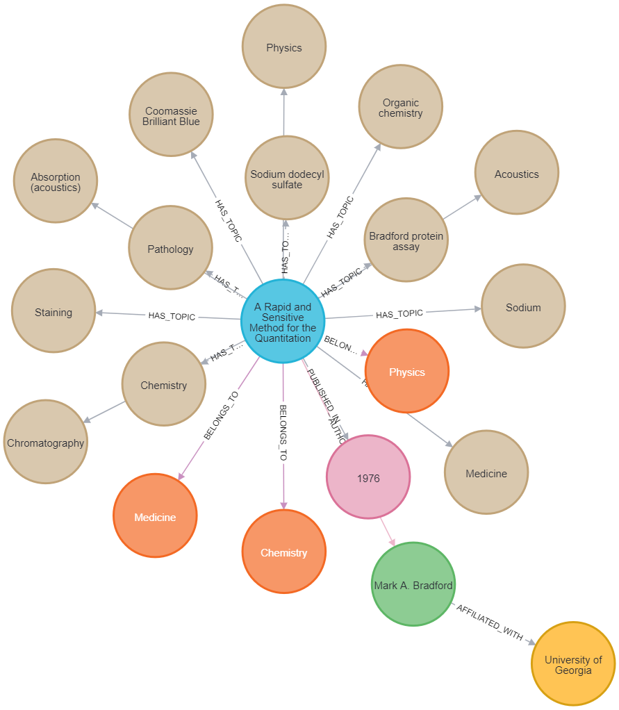
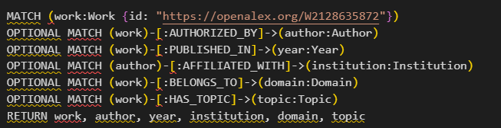
Example query with Knowledge graph
Notes:
This graph gives a multi-dimensional view of the work's context, such as topics, authorship, and institutional influence.
This single query consolidates a wealth of connected data that would be cumbersome to gather in traditional databases.

Slide 25
A quick walk through the code, Knowledge graphs and relationships covered.
Work – AUTHORIZED_BY → Authors
Work – PUBLISHED_IN → Year
Authors – AFFILIATED_WITH → Institutions
Work – BELONGS_TO → Domains
Work – HAS_Topic → Topics

Slide 26
Issues faced with Neo4j
Project Saving Challenges: Unable to save projects directly within Neo4j, requiring external tools like Google Colab for code storage.
Code Snippet Loss: Initial Cypher code snippets disappear as more coding is done in the browser interface.
Integration Limitations: Difficulty connecting Neo4j projects to a GitHub repository for version control and collaboration.

Slide 27
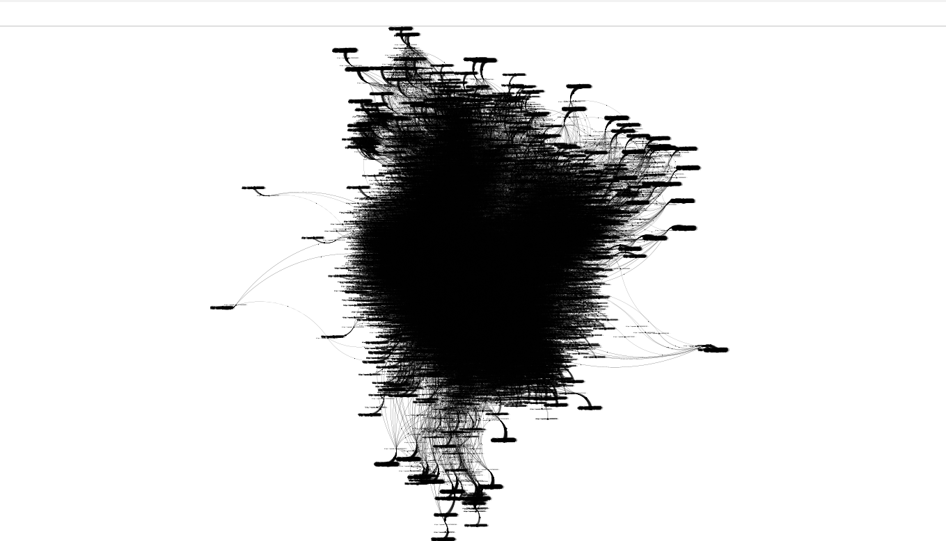
Output in Gephi
Open-source tool for visualizing and analyzing networks.
User-friendly interface for customizable graph layouts.
Handles large datasets and calculates network metrics.
Ideal for social network analysis and knowledge graphs.
Graph Shows:
The graph's density (black cluster) suggests a highly connected network with many relationships.
Specific nodes may vary in size or color (if styled) to indicate metrics such as centrality, importance, or degree of connectivity.

Slide 28
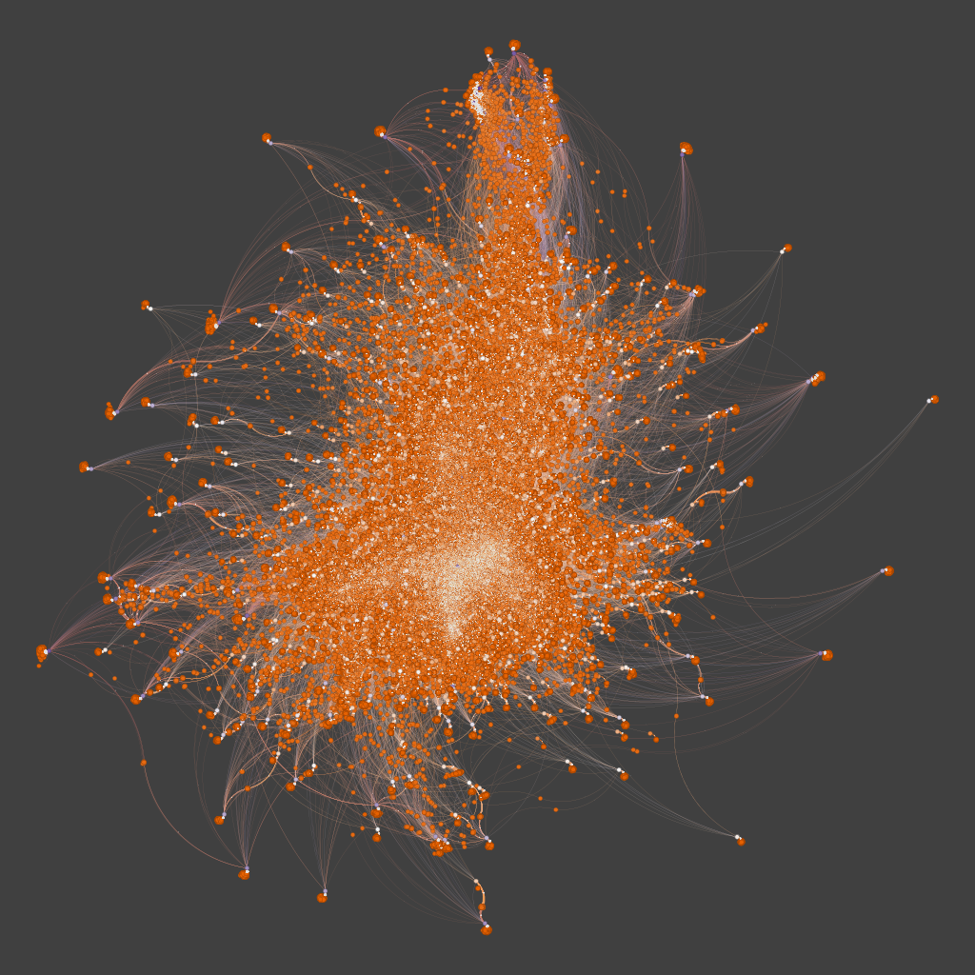
Better Output so far

Slide 29
Issues with Gephi
Trying to model better the entity-relationship pattern
There are some issues regarding data visualization in Gephi
Lack of experience

Slide 30
Remaining work
Will try to cover Cites and Cited by relationship.
Work around more with Gephi to improve visualizations
Complete the report.

Slide 31
Thank You ☺

Slide 32
References
https://docs.openalex.org/
https://docs.openalex.org/#why-openalex
https://docs.openalex.org/quickstart-tutorial
https://openalex.org/about
https://docs.openalex.org/download-all-data/openalex-snapshot

